Slide 1
Employee Data Analysis using Excel
STUDENT NAME: Mythili G
REGISTER NO: 312209109
DEPARTMENT: Commerce
COLLEGE: Anna Adarsh College for Women

Slide 2
PROJECT TITLE
Employee Performance Analysis using Excel

Slide 3


AGENDA
Problem Statement
Project Overview
End Users
Our Solution and Proposition
Dataset Description
Modelling Approach
Results and Discussion
Conclusion
3/21/2024 Annual Review

Slide 4

PROBLEM STATEMENT
We need to analyze employee performance using Excel to improve productivity and satisfaction. The task involves collecting data on key performance indicators (KPIs) such as productivity, quality of work, and attendance. Organize this data into structured tables, calculate performance metrics, and use Excel's charting tools to identify trends and patterns.
This analysis aims to provide actionable insights for enhancing overall performance and employee engagement.
Develop a dashboard to present key findings, including high and low performers and areas needing improvement.

Slide 5

PROJECT OVERVIEW
Objective: The goal of this project is to utilize Excel to analyze and evaluate employee performance across various metrics to identify strengths, weaknesses, and opportunities for improvement.
Scope:
Data collection.
Trend analysis.
Benchmarking.
Reporting.
Performance metrics.
Deliverables: A well-organized dataset with clear categories. Calculated performance metrics and visual trend analysis. A dashboard or summary report highlighting key findings and areas for improvement.

Slide 6

WHO ARE THE END USERS?
HR Managers:
They use the data to assess employee performance, make decisions on promotions, and implement development programs
Department Heads/Managers:
They analyze the performance of their team members to provide feedback, allocate resources effectively, and address performance issues.
Senior Executives:
They review aggregated performance data to make strategic decisions about workforce planning and overall organizational effectiveness.
Team Leaders/Supervisors:
They use the analysis to provide individual feedback, set performance goals, and track progress.
Employees:
They might access their own performance data to understand their progress and identify areas for personal improvement.

Slide 7

OUR SOLUTION AND ITS VALUE PROPOSITION
Solutions:
Centralized Data Management: Excel organizes performance data in a structured way, ensuring consistency and easy access.
Automated Metrics Calculation: Formulas streamline the calculation of performance indicators, reducing manual errors.
Trend Analysis: Excel’s charts and graphs visually represent performance trends, aiding in quick identification of patterns.
Benchmarking: Comparing individual performance with department averages highlights high and low performers.
Comprehensive Reporting: Dashboards provide actionable insights and recommendations for data-driven decisions.
Value Proposition:
These solutions enhance decision-making, improve efficiency, and offer valuable insights into performance trends, leading to better management and strategic planning.

Slide 8
Dataset Description
Employee Details:
Employee ID: Unique identifier for each employee.
Name: Full name of the employee.
Department: The department or team the employee belongs to.
Position: Job title or role within the company.
Performance Metrics:
Productivity Score: Quantitative measure of output or results (e.g., sales figures, project completions).
Quality of Work: Assessment of work accuracy and adherence to standards (e.g., error rates, quality reviews).
Attendance Records: Data on days present, absences, and tardiness.
Project Completion Rate: Percentage of projects completed on time or ahead of schedule.
Time Period:
Date Range: The period during which the performance data is collected (e.g., monthly, quarterly).

Slide 9

THE "WOW" IN OUR SOLUTION
Our solution stands out by seamlessly integrating comprehensive performance data with powerful Excel features, delivering actionable insights through a user-friendly interface.
By centralizing and automating data management, we provide accurate and up-to-date performance metrics with minimal manual effort.
The dynamic visualization tools enable intuitive trend analysis and pattern recognition, making complex data easy to interpret.
Additionally, our benchmarking capabilities highlight exceptional and underperforming employees, facilitating targeted interventions.
The result is a streamlined, data-driven approach to performance management that enhances decision-making and drives organizational success.
3/21/2024 Annual Review
9

Slide 10
MODELLING
To use conditional formatting in Excel:
Select Cells: Highlight the range you want to format.
Apply Conditional Formatting: Go to Home > Conditional Formatting.
Choose a Rule: Pick from options like Highlight Cells Rules, Data Bars, Color Scales, or Icon Sets.
Set Criteria: Define the condition (e.g., greater than, top 10%) and select a format.
Manage Rules: Edit or remove rules via Conditional Formatting > Manage Rules if needed.
To analyze employee performance using a PivotTable in Excel:
Select Data: Highlight your dataset with employee performance information.
Insert PivotTable: Go to the "Insert" tab and click "PivotTable.
"Set Up PivotTable: Choose where to place the PivotTable (new worksheet or existing).
Arrange Fields: Drag fields into the "Rows," "Columns," "Values," and "Filters" area
1. Rows: Employee names or departments.
2.Columns: Performance metrics or time periods.
3.Values: Performance scores, totals, or averages.
10

Slide 11
Filters: Criteria to refine the data (e.g., specific time periods or departments). Analyze Data: Use the PivotTable to summarize and analyze performance data, identify trends, and compare metrics.
To create a column chart for employee performance analysis in Excel, follow these steps:
1.Prepare Data:
Arrange your data in columns.
2.Select Data:
Highlight the data range, including headers.
3.Insert Column Chart:
Go to the "Insert" tab on the Ribbon. Click on "Column Chart" in the Charts group. Choose the desired column chart type (e.g., Clustered Column).
4.Customize Chart:
Add titles and labels for clarity. Adjust colors or styles as needed using the Chart Tools.

Slide 12
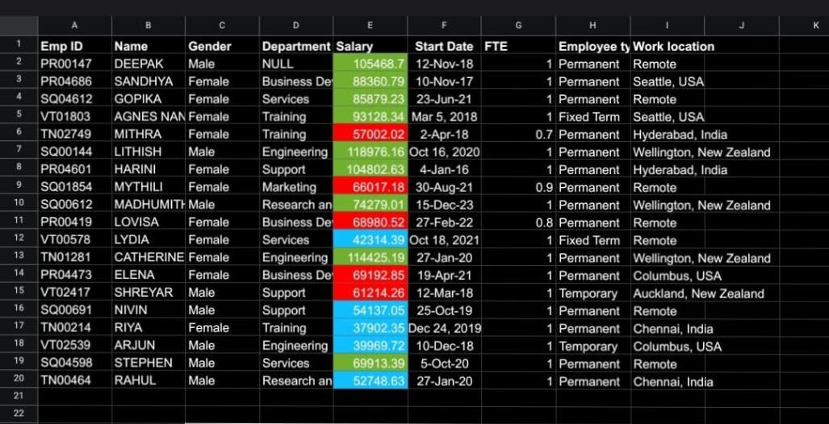
RESULTS
CONDITIONAL FORMATTING
12

Slide 13
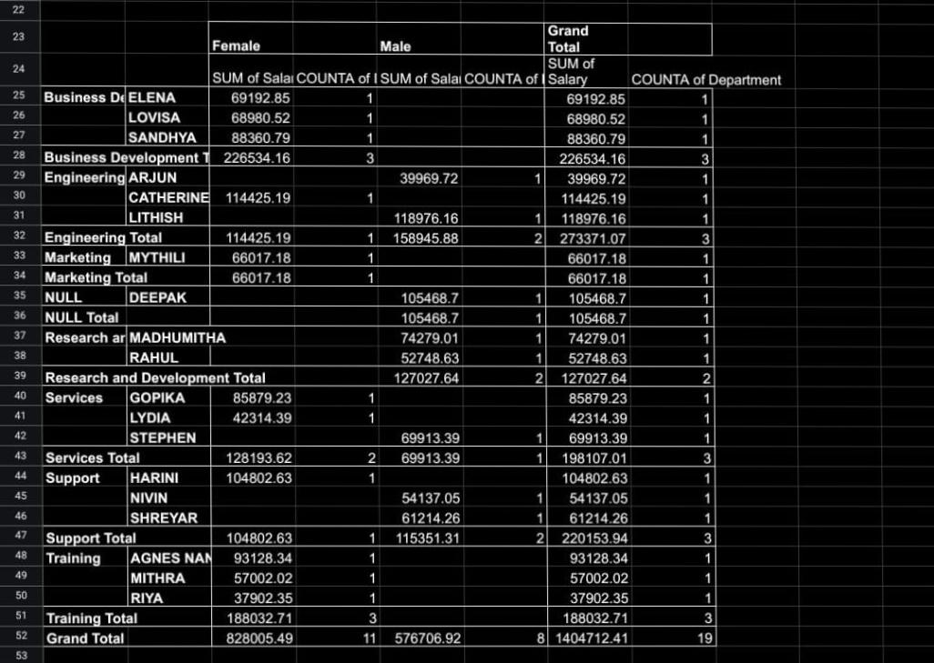
PIVOT TABLE

Slide 14
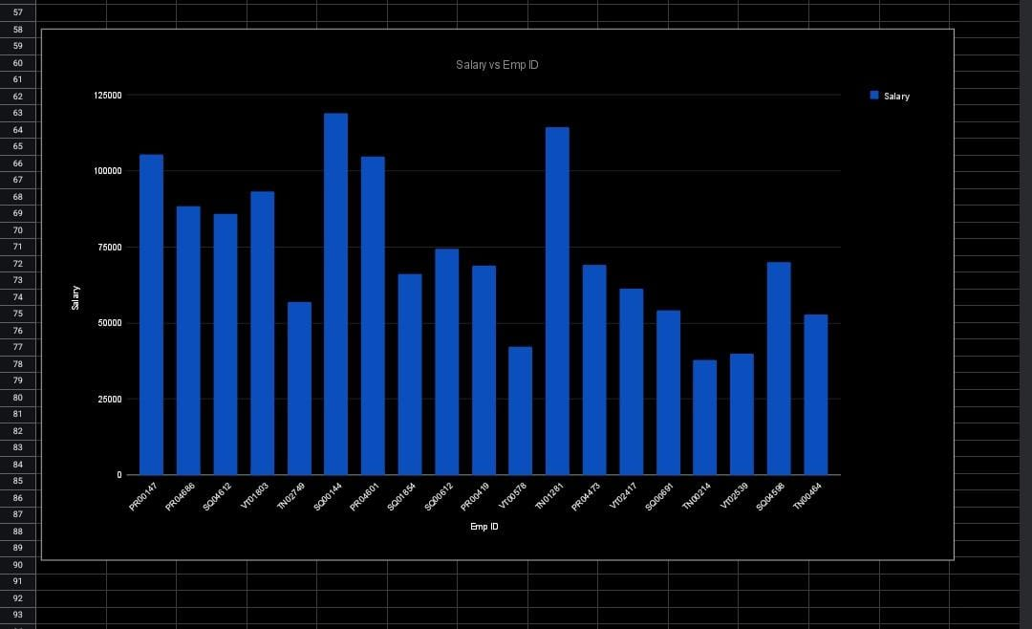
PIE CHART

Slide 15
conclusion
Analyzing employee performance using Excel provides a clear, data-driven perspective on various metrics such as productivity, attendance, and quality of work. By leveraging Excel’s functions and features—like pivot tables, charts, and conditional formatting—you can identify trends, recognize top performers, and pinpoint areas for improvement. This analysis facilitates informed decision-making, helps in setting performance benchmarks, and supports tailored training and development programs. Overall, it enhances the effectiveness of performance management by turning raw data into actionable insights.

